Slide 1

Practical 7

Slide 2
Case and Character Manipulation, Number and Date Functions

Slide 3
Chapter Objectives
Use the UPPER, LOWER, and INITCAP functions to change the case of field values and character strings
Extract a substring using the SUBSTR function
Determine the length of a character string using the LENGTH function

Slide 4
Chapter Objectives
Use the LPAD and RPAD functions to pad a string to a desired width
Use the LTRIM and RTRIM functions to remove specific characters strings
Round and truncate numeric data using the ROUND and TRUNC functions
Calculate the number of months between two dates using the MONTHS_BETWEEN function

Slide 5
Chapter Objectives
Identify and correct problems associated with calculations involving null values using the NVL function
Display dates and numbers in a specific format with the TO_CHAR function
Determine the current date setting using the SYSDATE keyword
Nest functions inside other functions
Identify when to use the DUAL table

Slide 6
Terminology
Function – predefined block of code that accepts arguments
Single-row Function – returns one row of results for each record processed
Multiple-row Function – returns one result per group of data processed

Slide 7
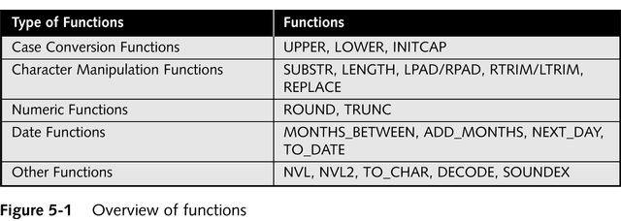
Types of Functions

Slide 8
Case Conversion Functions
Alter the case of data stored in a column or character string

Slide 9
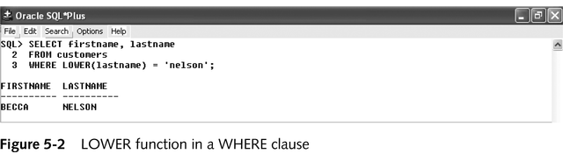
LOWER Function
Used to convert characters to lower-case letters

Slide 10
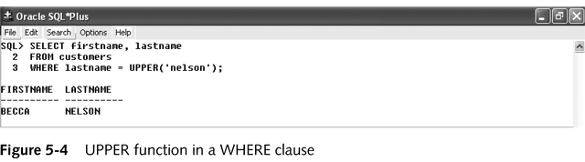
UPPER Function
Used to convert characters to upper-case letters

Slide 11
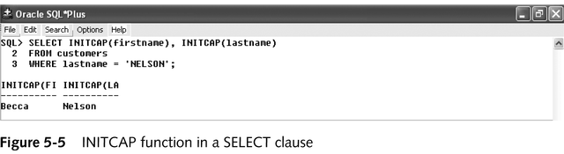
INITCAP Function
Used to convert characters to mixed-case

Slide 12
Eg:-
SELECT UPPER(term_desc)
FROM term
WHERE term_id=1;
SELECT INITCAP(bldg_code)
FROM location
WHERE loc_id=1;
Chapter 5

Slide 13
Character Manipulation Functions
Manipulates data by extracting substrings, counting number of characters, replacing strings, etc.

Slide 14
SUBSTR Function
(SUBSTR(string, start_position, length))
Used to return a substring, or portion of a string
eg. SELECT SUBSTR(term_desc,6,4)
FROM term
WHERE term_id=1;

Slide 15
LENGTH Function
Used to determine the number of characters in a string
Eg. SELECT LENGTH(o_methpmt)
FROM orders
WHERE o_id = 1;

Slide 16
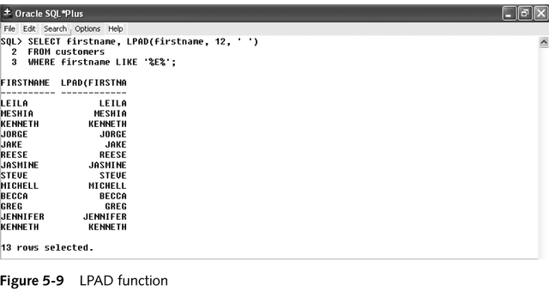
LPAD and RPAD Functions
Used to pad, or fill in, a character string to a fixed width

Slide 17
Eg.
SELECT LPAD(meth_pmt,5, ‘*’), RPAD(meth_pmt, 5, ‘*’) WHERE order_id=1;
Chapter 5
Oracle9i: SQL

Slide 18
LTRIM and RTRIM Functions
Used to remove a specific string of characters
Eg. SELECT LTRIM(call_id, ‘MIS’)
FROM course
WHERE course_id = 1;

Slide 19
REPLACE Function
Substitutes a string with another specified string
Eg. SELECT REPLACE(term_desc,’200’,’199’)
FROM term
WHERE term_id = 1;

Slide 20
CONCAT Function
Used to concatenate two character strings
Eg. SELECT CONCAT(f_last,f_rank)
FROM faculty
WHERE f_id= 1;

Slide 21
Number Functions
Allows for manipulation of numeric data

Slide 22
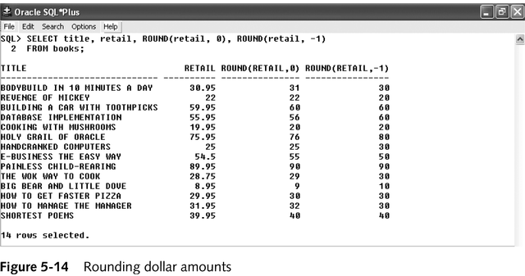
ROUND Function
Used to round numeric columns to a stated precision

Slide 23
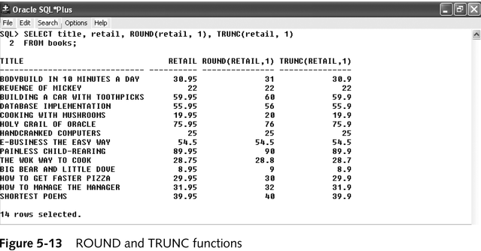
TRUNC Function
Used to truncate a numeric value to a specific position

Slide 24
Date Functions
Used to perform date calculations or format date values

Slide 25
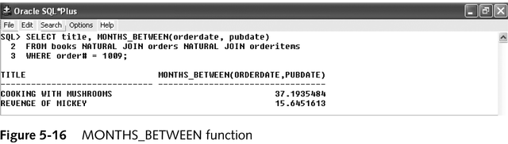
MONTHS_BETWEEN Function
Determines the number of months between two dates

Slide 26
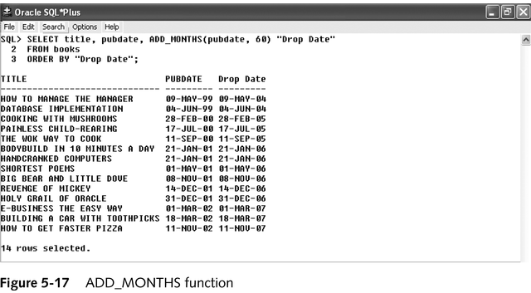
ADD_MONTHS Function
Adds a specified number of months to a date

Slide 27
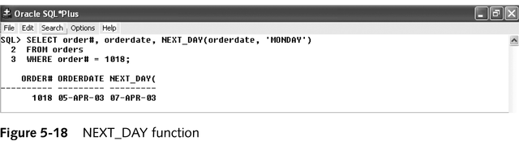
NEXT_DAY Function
Determines the next occurrence of a specified day of the week after a given date

Slide 28
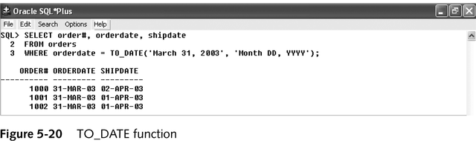
TO_DATE Function
Converts various date formats to the internal format (DD-MON-YYYY) used by Oracle9i

Slide 29
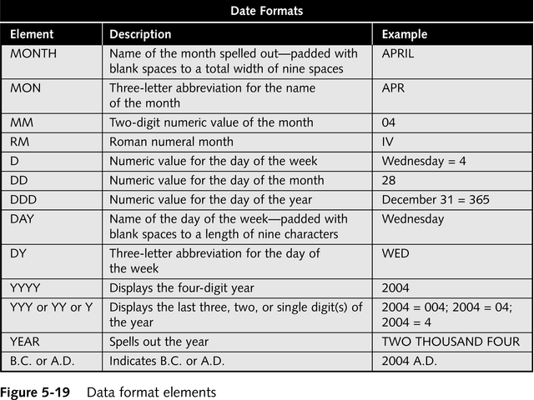
Format Model Elements - Dates

